Slide 1
Student Report Card System
By Team Data Generation

Slide 2
Submitted To Professor Mohammed Shamsul Alam Dept. of CSE, IIUC
Submitted By
Tehsim Fariha (C193207)
Sadiya Afrin Priya (C193228)
Qareena Huq (C193246)
Nafija Tabassum Nirjana (C191219)

Slide 3
Introduction
Making report card manually for all of the student in educational institution, it's hard. So, solving this problem, it’s better to achieve this work using computer system.
System will provide print facility by which, it will enable them to display the marks of each student on paper by just one click.
Time saving
Reduce Physical work load

Slide 4
Features
User Friendly
Every Function works smoothly
Handle Multiple Students Result sheets at the same Time.

Slide 5
Development Tools
C++ as Programming Language
For storing data permanently we have used file

Slide 6

Block Diagram
*Create Student Record
*Display Menu
*Search Menu
*Modify Menu
*Delete Individual Menu
*Delete Single Menu
Menu
Process
Output

Slide 7

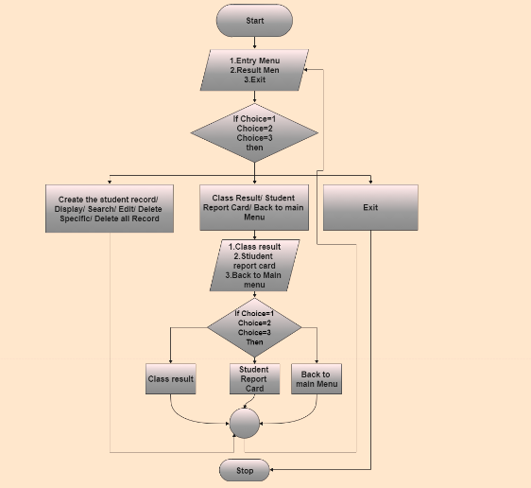
Flow Chart

Slide 8
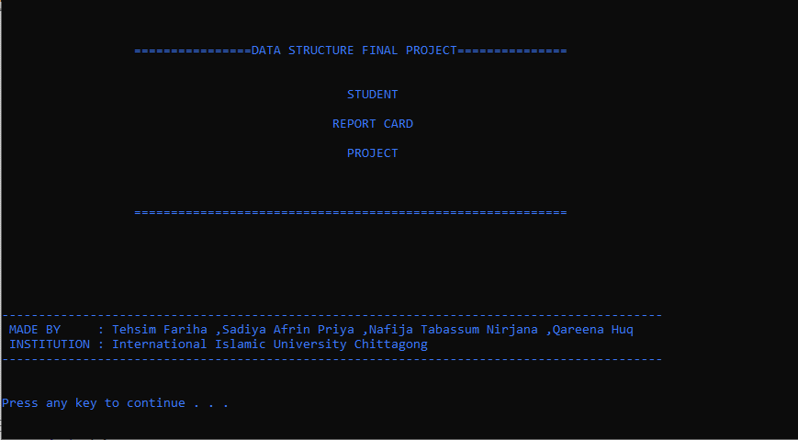
Output

Slide 9
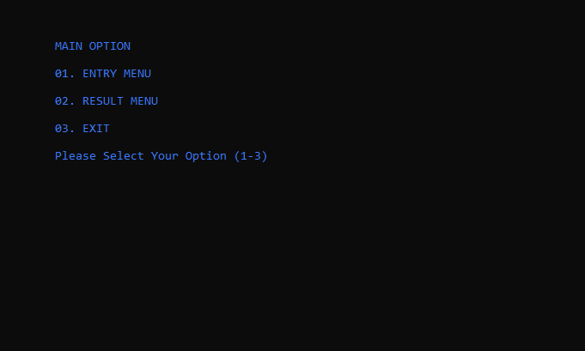

Slide 10
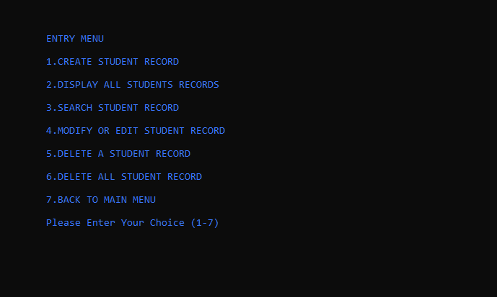

Slide 11
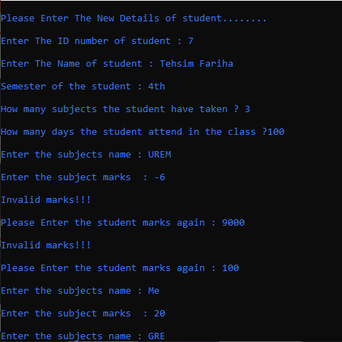

Slide 12
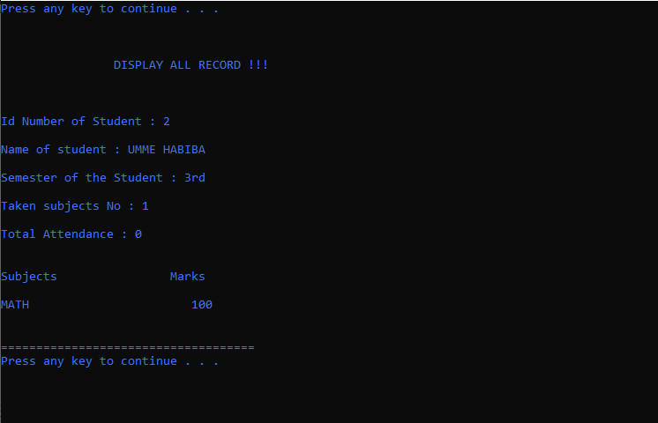

Slide 13
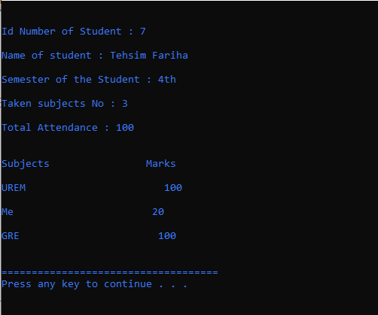

Slide 14
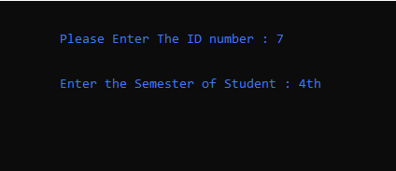

Slide 15
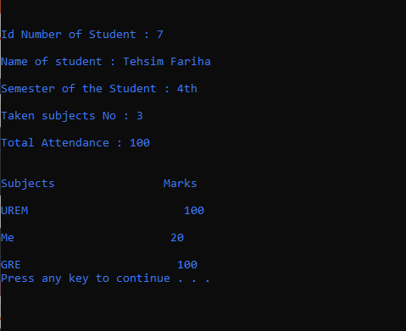

Slide 16
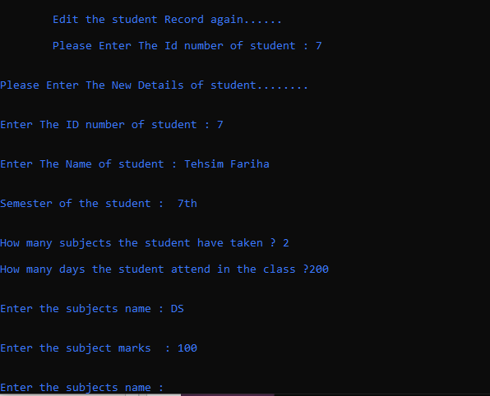

Slide 17
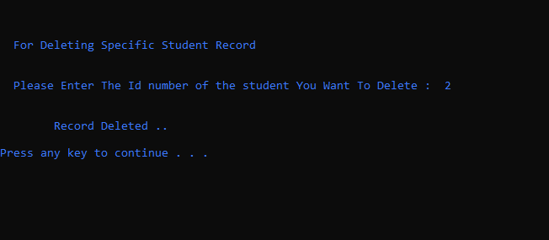

Slide 18
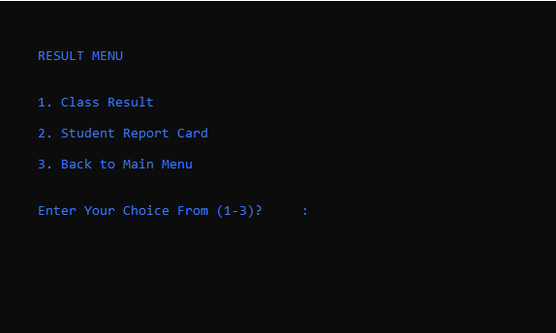

Slide 19
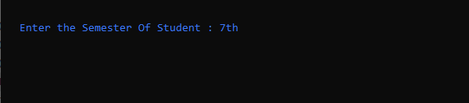

Slide 20
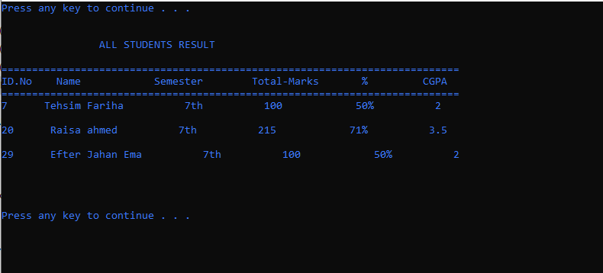

Slide 21
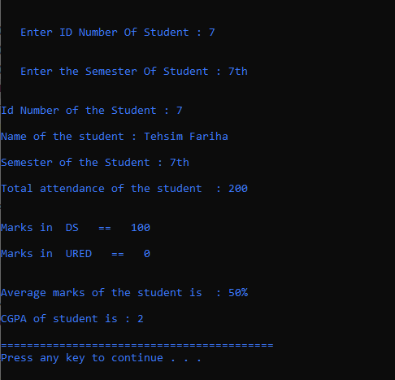


Slide 22
Future Scope
Student Improvement Subject List
Student Payment History
Web base Student Report Card System

Slide 23
Thank You

